Slide 1
Revisiting Prac 3

Slide 2






Week 3 Goal
Enable programming on Raspberry Pi
Jumper wire,
UART
Arduino
Program (.ino)
Bluetooth,
UART
Python
Program (.py)
Internet
Protocol
DHT11
Sensor
AWS
Teensy (8-bit CPU,
ATMEGA32U4)
Rpi 4 (64-bit CPU,
ARM Cortex-A72)

Slide 3
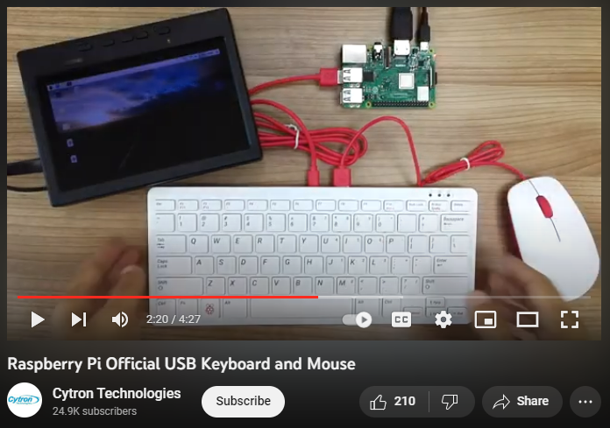
Easy Solution - Keyboard, mouse and screen

Slide 4

Work-around – Secure Shell (SSH)
SSH is the mean, not the goal.
Python
Program (.py)
SSH
Use VNC viewer to see the screen
and code in Python
Rpi 4 (64-bit CPU,
ARM Cortex-A72)

Slide 5
SSH over Wireless Local Area Network
QUT Wi-Fi or personal hotspot (some of you tried this last week)
For stable access let’s default to QUT wi-fi while on campus.
https://github.com/EsperLiu/IFN649/
Put wpa_supplicant.conf in the SD card’s root folder; RPi will then connect to QUT Wi-Fi on startup.
The method shown in recording does not support MS-CHAPv2, which is used by QUT.

Slide 6
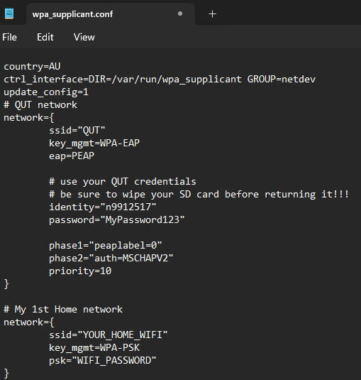
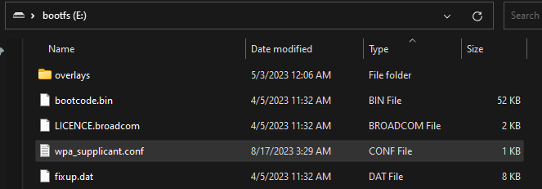

Slide 7


AWS EC2 Instance
MQTT Broker
“Hello World”
“Hello World”
SSH Connection
Client
(publisher)
Client
(subscriber)

Slide 8

AWS EC2 Instance
Arduino
Program (.ino)
Bluetooth,
UART
Python
Program (.py)
MQTT Publish (over IP)
MQTT Broker
Teensy (8-bit CPU,
ATMEGA32U4)
Rpi 4 (64-bit CPU,
ARM Cortex-A72)
MQTT Subscriber

